Slide 1

Data Science Onboarding Session
DATA
Praise Ekeopara, ML Engineer @Techpet Global Ltd.

Slide 2



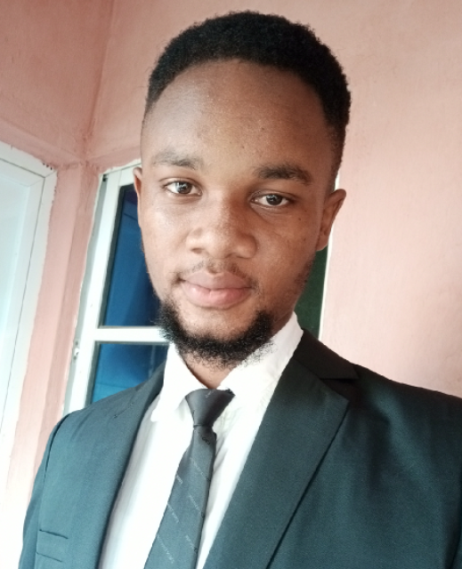
About me
I’m Praise, the Data Science guy !

Slide 3


The Journey of Learning
Skills
Programming
Applied Mathematics
Data Visualization
Statistics
Machine learning etc.

Slide 4
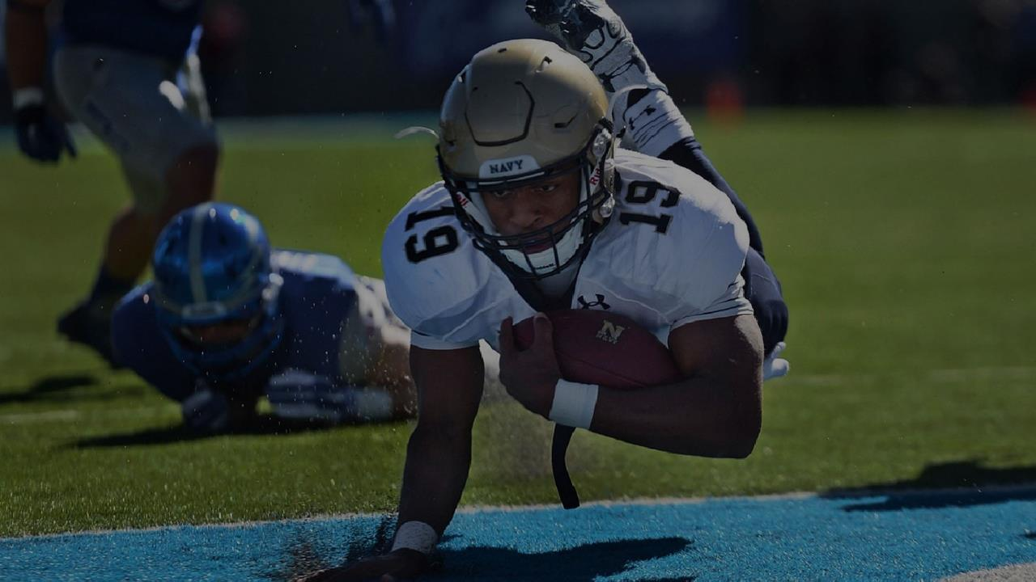



Training Methods to be adopted
Teaching
Practical coding
Projects
Assignment & Solution presentations

Slide 5




Our Learning Culture
Creativity
2. Consistency
3. Resilience
Excellence

Slide 6



Is time to begin this exciting journey
Lets then curate your training contents

